Slide 1

Predictive Analytics in Business (BUAN 448)
BUAN 488 – Fall 2022 – Dr. Davoodi

Slide 2
Simple Linear Regression

Slide 3
Predictive Analytics
Main idea:
If we can quantify the relationship of how a single variable (referred as “dependent variable”) depends on other variables (referred as “independent” or “explanatory” variables)
→ then we can predict the unknown/future values and trends of the dependent variable using the values of these other variables
INFORMS Body of Analytics, Wiley 2018

Slide 4
Examples
How do wages of employees depend on years of experience?
How does the selling price of a house depend on square footage and number of bedrooms?
Can we predict the final grade in a class as a function of time spent studying?
Can we predict the monthly income of an individual by their ZIP code?
Can we predict the monthly income of an individual by their ZIP code, education level, age, and gender?
Note: Dependent variable is numerical, independent variables can be numerical or categorical

Slide 5
Quantifying the relationship between two variables
Assume our healthcare wearables company is interested in finding out how the amount spent in promotional material/month [$] impacts the monthly sales [$]
Dependent variable?
Independent variable?

Slide 6
Quantifying the relationship between two variables
Assume our healthcare wearables company is interested in finding out how the amount spent in promotional material/month [$] impacts the monthly sales [$]
Dependent variable: monthly sales [$]
Independent variable: amount spent in promotional material/month [$]
Which method(s)/visualization tools we learned in class can we use to quantify the linear relationship between two numerical variables?

Slide 7
Quantifying the relationship between two variables
Assume our healthcare wearables company is interested in finding out how the amount spent in promotional material/month [$] impacts the monthly sales [$]
Dependent variable: monthly sales [$]
Independent variable: amount spent in promotional material/month [$]
Which method(s)/visualization tools we learned in class can we use to quantify the linear relationship between two numerical variables?
Scatter plot
Correlation

Slide 8
Quantifying the relationship: Correlation as Indicator of Linear Relationships
Sign of the correlation can tell whether the two variables are positively or negatively related
A correlation close to 1 indicates a strong positive linear relationship
A correlation close to -1 indicates a strong negative linear relationship
A correlation equal to 0 (or near 0) indicates no linear relationship
Dependent
variable
Independent variable

Slide 9
Quantifying the relationship between two variables
Scatterplots and correlations are useful for indicating direction and strength of the relationship between variables
But do they quantify the relationship?
In other words, can we predict how (by how much) one variable changes if the other variable changes by one unit?
Ch6_0.R

Slide 10
Quantifying the relationship between two variables
Example: Assume we run the analysis, and correlation between amount spent in promotional material/month [$] and monthly sales [$] is 0.85, scatter plot is shown below
Our manager asks: What would be the monthly sales next month if we spend $15,000 for promotional material next month?
Monthly sales [$]
Promotional expenditure/ month [$]

Slide 11
Quantifying the relationship between two variables
Example: Assume we run the analysis, and correlation between amount spent in promotional material/month [$] and monthly sales [$] is 0.85, scatter plot is shown below
Our manager asks: What would be the monthly sales next month if we spend $15000 for promotional material next month?
We can’t answer this question by just using scatter plot and correlation
Monthly sales [$]
Promotional expenditure/ month [$]

Slide 12
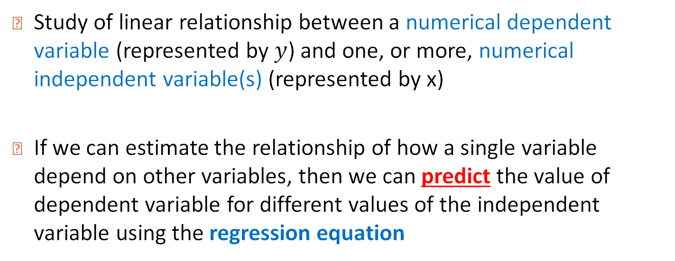
Linear Regression Analysis
Study of linear relationship between a numerical dependent variable (represented by $y$) and one, or more, numerical independent variable(s) (represented by x)
If we can estimate the relationship of how a single variable depend on other variables, then we can predict the value of dependent variable for different values of the independent variable using the regression equation

Slide 13

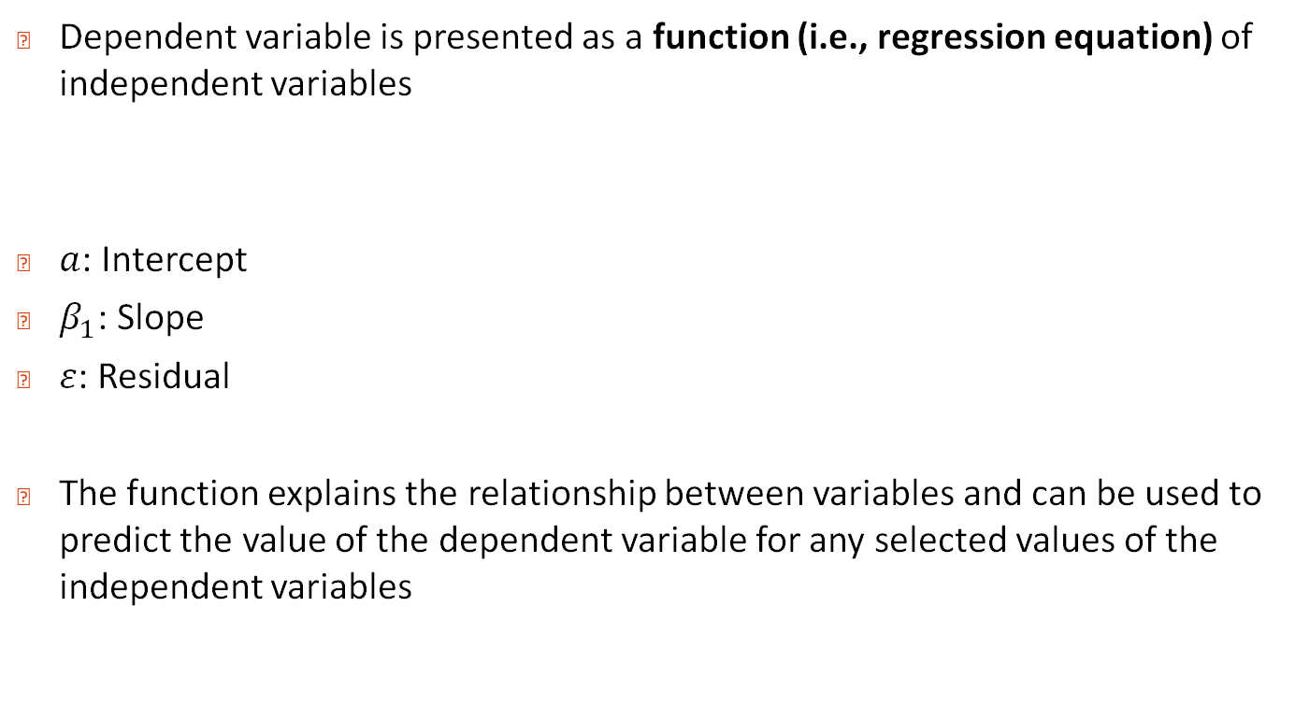
Regression Equation
Dependent variable is presented as a function (i.e., regression equation) of independent variables
$a$: Intercept
$β_{1}$: Slope
$ε$: Residual
The function explains the relationship between variables and can be used to predict the value of the dependent variable for any selected values of the independent variables
$$y=a+β_{1}x_{1}+ε$$

Slide 14
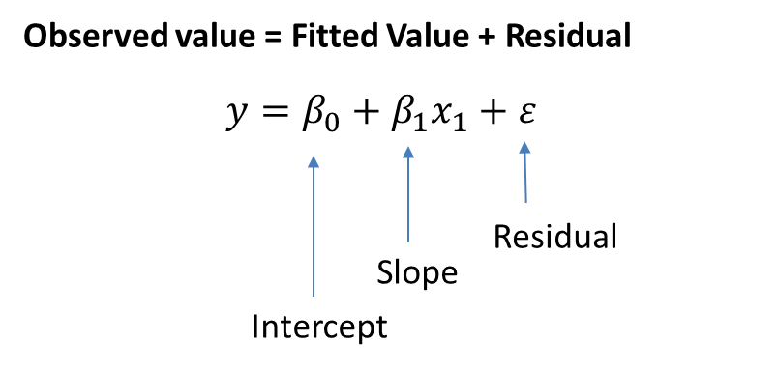


Linear Regression Equation
How much _____(y) do I get for a unit rise in_________(x₁) ?
Independent variable (x₁) enters regression equation as multiple of a coefficient ($β_{1}$)
$$y=a+β_{1}x_{1}+ε$$

Slide 15
Simple Linear Regression
Examples
Sales (y) as a function of promotional expenditures (x)
Grade (y) as a function of time spent on studying for an exam (x)
Income (y) as a function of Highest earned degree (x)

Slide 16
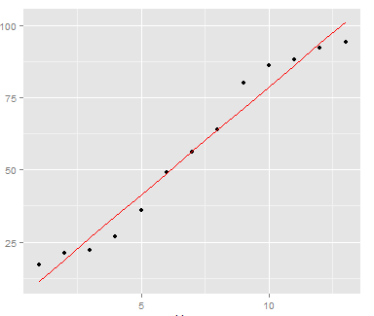
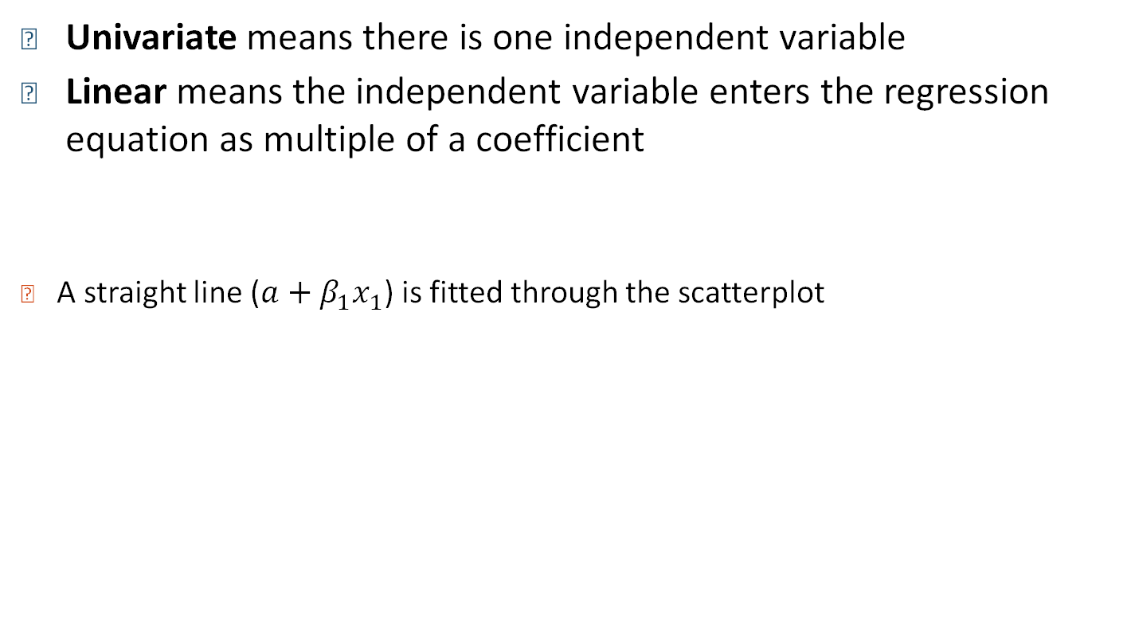

Univariate Linear Regression
Univariate means there is one independent variable
Linear means the independent variable enters the regression equation as multiple of a coefficient
A straight line ($a+β_{1}x_{1}$) is fitted through the scatterplot
$$y=a+β_{1}x_{1}+ε$$
Dependent
Variable
(y)
Independent variable (x)

Slide 17
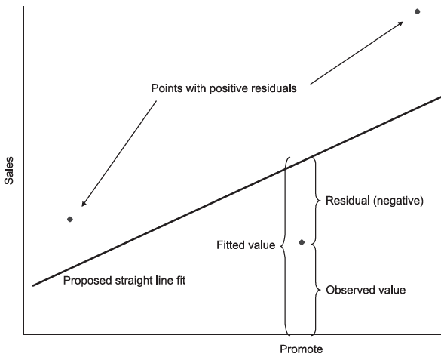
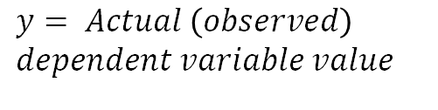
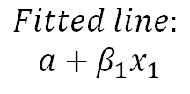
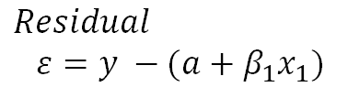
Univariate Linear Regression: Fitted line
Linear regression finds the best-fitting line through the points of a scatterplot with the smallest sum of squared residuals
Example: Sales (y) as a function of Promotional expenditures (x)
Ch6_0.R
Monthly
Sales (y)
$$Fitted line:$$
$$a+β_{1}x_{1}$$
$$Residual$$
$$ε=y −(a+β_{1}x_{1})$$
$$y= Actual \left(observed\right)$$
$$dependent variable value$$
Promotional expenditure/month (x)

Slide 18
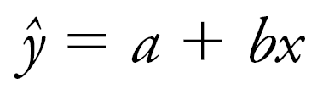
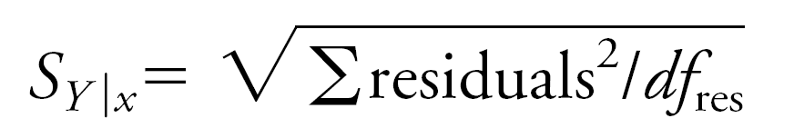
Simple Regression Model
Regression coefficients are estimated by minimizing ∑residuals² (i.e., sum of the squared residuals) to derive this model:
The standard error of the regression (s_{Y|x}) is based on the squared residuals:

Slide 19
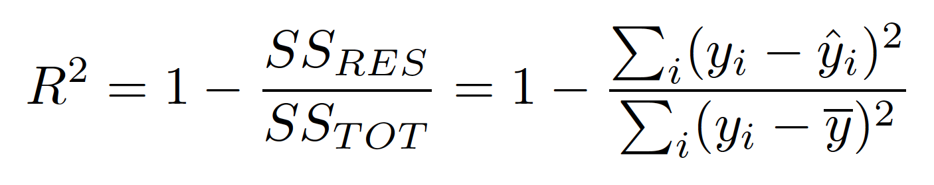
The Percentage of Variation Explained: R-Square
R Square is a measure of goodness of fit of the least squares line for univariate linear regression
Percentage of variation of the dependent variable explained by the regression
Always ranges between 0 and 1
The better the linear fit is, the closer R Square is to 1

Slide 20
R-squared
High R-squared value indicates that the fitted line captures most of the variation in the data → data points are close to the fitted line
Low R-squared value indicates that the fitted line does not capture the variation in the data → data points are more scattered

Slide 21
Simple Linear Regression
Regression equation
Predicted final grade = 0.907 + 0.996*Midterm Grade
R-square = 0.579
That means using midterm grade as the independent variable for predicting final grade explains 57.9% of the variation in Y (final grade)
Ch6_0.R

Slide 22
Multiple Linear Regression

Slide 23
Regression Analysis Types
Based on number of independent variables
Simple (univariate) regression
Multiple regression

Slide 24



Univariate vs Multiple Regression
If there is a single independent variable: univariate(simple) regression
Example
Independent variable $x_{1}$= Age
Dependent variable $y$ = Risk of heart attack
If there are several independent variables: multiple regression
Example
Independent variables $x_{1}$= Age, $x_{2}$= Gender, $x_{3}$= BMI
Dependent variable $y$= Risk of heart attack
$$y=a+β_{1}x_{1}+ε$$
$$y=a+β_{1}x_{1}+β_{2}x_{2}+…+β_{k}x_{k}+ε$$

Slide 25
Examples
Independent variables ={Age, Gender, Diet, Exercise level}
Dependent variable = {Risk of a heart attack}
Independent variables ={Square footage, number of bedrooms}
Dependent variable = {Selling price of a house}
Independent variables ={ZIP code, education level, age, gender}
Dependent variable = {Monthly income of an individual}

Slide 26
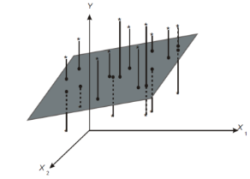

Univariate vs Multiple Regression: Graphical Comparison
Graphically, in univariate regression we are fitting a line to a set of points
In multiple regression, if there are two independent variables, we are fitting a plane to the data in three-dimensional space
$$y=a+β_{1}x_{1}+β_{2}x_{2}+ε$$

Slide 27
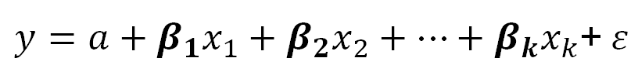
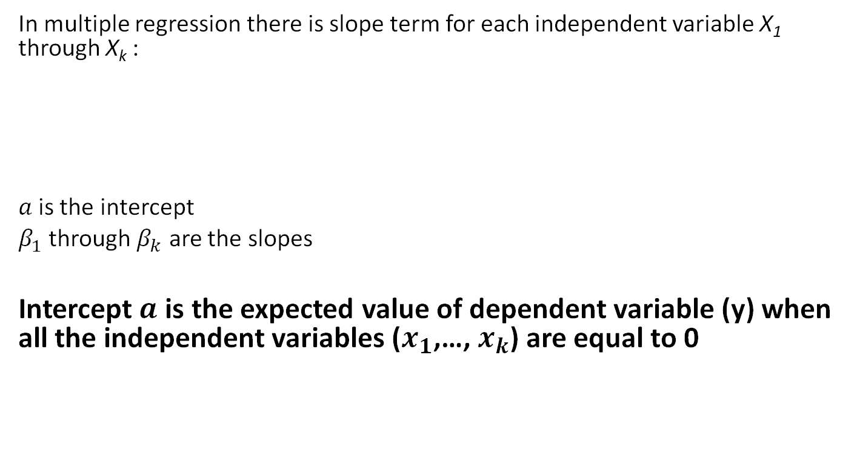
Interpretation of Regression Coefficients
In multiple regression there is slope term for each independent variable X₁ through X_{k} :
$a$is the intercept
$β_{1}$ through $β_{k}$ are the slopes
Intercept$a$ is the expected value of dependent variable (y) when all the independent variables ($x_{1}$,…, $x_{k}$) are equal to 0
$y=a+β_{1}x_{1}+β_{2}x_{2}+…+β_{k}x_{k}$+$ε$

Slide 28
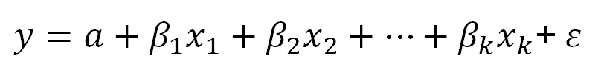
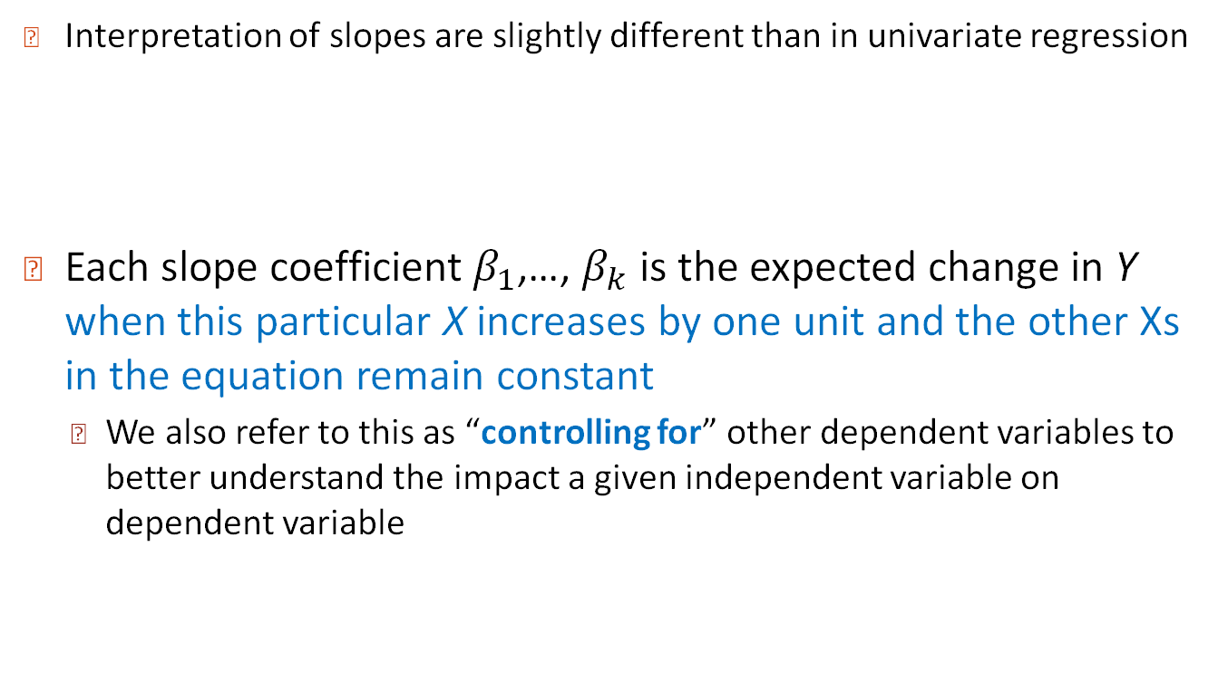
Interpretation of Regression Coefficients
Interpretation of slopes are slightly different than in univariate regression
Each slope coefficient $β_{1}$,…, $β_{k}$ is the expected change in Y when this particular X increases by one unit and the other Xs in the equation remain constant
We also refer to this as “controlling for” other dependent variables to better understand the impact a given independent variable on dependent variable
$y=a+β_{1}x_{1}+β_{2}x_{2}+…+β_{k}x_{k}$+$ε$

Slide 29
Interpretation of Regression Coefficients
Multiple Regression equation:
BAC = 0.039 + 0.02*Number of beers – 0.00036*Weight
Interpretation of the coefficients:
Weight coefficient: If two people consumed the exact same number of beers, the person who is heavier have a lower BAC → 0.00036 decrease for each additional pound
Beer coefficient: If two people had the exact same weight, the person who had one more beer will have a higher BAC → 0.02 increase BAC for each additional beer
Blood Alcohol Level

Slide 30
Recall: Percentage of Variation Explained using R-Square
R Square is a measure of goodness of fit of the least squares line for univariate linear regression
Percentage of variation of the dependent variable explained by the regression
Always ranges between 0 and 1
The better the linear fit is, the closer R Square is to 1
R-Square has a drawback: It can only increase when additional independent variables are added to the regression model

Slide 31
Interpretation of R-Square and Adjusted R-Square
Adjusted R-Square is an alternative measure that adjusts R² for the number of explanatory variables in the equation
Helps to monitor whether extra explanatory variables really belong in the equation
It can decrease if unnecessary variables are added to the multivariate regression model
Penalty for number of predictors that do not fit the model

Slide 32

Key Insight: R Square, Adjusted R Square, and Standard Error of Estimate Important!!!
Sometimes a regression equation is “built” by successively adding independent variables to an equation – assuming more variables is better…
As more independent variables are added, it is a mathematical fact that R Square must increase; it cannot decrease
However, the standard error of estimate can increase, and the adjusted R square can decrease
each signaling that the extra independent variables are not useful and should probably be omitted from the equation

Slide 33
Regression Analysis Types
Based on the purpose
To understand the relationship between variables
To predict future (unknown) values of the dependent variable using the independent variables

Slide 34
Explanatory Modeling
Goal: Explain relationship between predictors (explanatory variables) and target
Familiar use of regression in data analysis
Model Goal: Fit the data well and understand the contribution of explanatory variables to the model
“goodness-of-fit”: R², residual analysis, p-values

Slide 35
Predictive Modeling
Goal: predict target values in other data where we have predictor values, but not target values
Classic data mining context
Model Goal: Optimize predictive accuracy
Train model on training data
Assess performance on validation (hold-out) data
Explaining role of predictors is not primary purpose (but useful)

Slide 36
Example: Prices of Toyota Corolla ToyotaCorolla.cvs
Goal: predict prices of used Toyota Corollas based on their specification
Data: Prices of 1442 used Toyota Corollas, with their specification information

Slide 37
Variables Used
Price in Euros
Age in months as of 8/04
KM (kilometers)
Fuel Type (diesel, petrol, CNG)
HP (horsepower)
Metallic color (1=yes, 0=no)
Automatic transmission (1=yes, 0=no)
CC (cylinder volume)
Doors
Quarterly_Tax (road tax)
Weight (in kg)

Slide 38
Preprocessing
Fuel type is categorical (in R - a factor variable), must be transformed into binary variables. R’s lm function does this automatically.
Diesel (1=yes, 0=no)
Petrol (1=yes, 0=no)
None needed* for “CNG” (if diesel and petrol are both 0, the car must be CNG)
*You cannot include all the binary dummies; in regression this will cause a multicollinearity error. Other data mining methods can use all the dummies.
Ch6_0.R
Multicollinearity: Two or more predictors in a regression model are highly correlated.

Slide 39
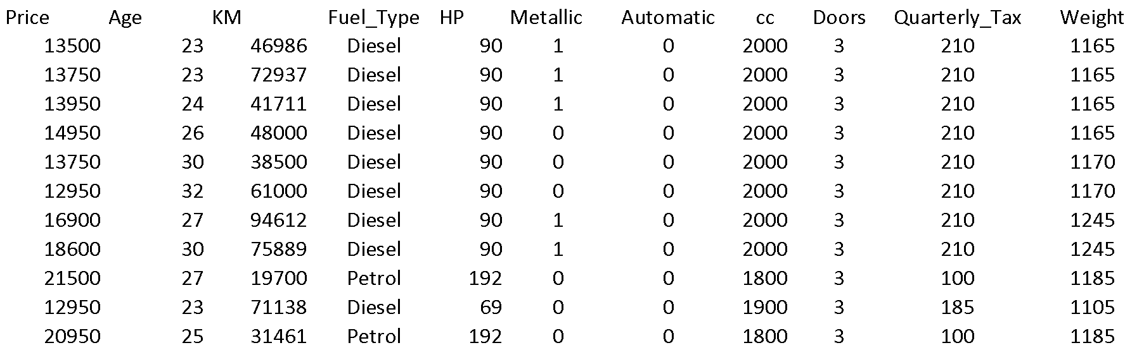
Data Sample (showing only the variables to be used in analysis)

Slide 40
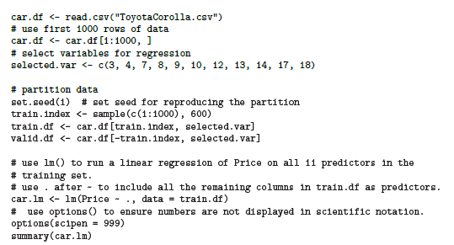
Fitting a Regression Model to the Toyota Data
put 60% in training
correction: 10
© Galit Shmueli and Peter Bruce 2017

Slide 41
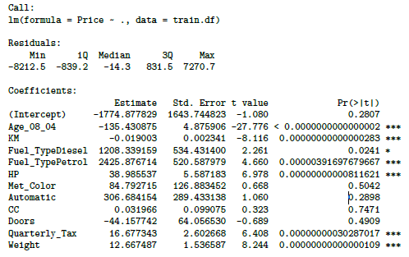
Output of the Regression Model
© Galit Shmueli and Peter Bruce 2017

Slide 42
Accuracy Metrics for the Regression Model
Residual standard error: 1406 on 588
degrees of freedom
Multiple R-squared: 0.8567
Adjusted R-squared: 0.854
F-statistic: 319.6 on 11 and 588 DF
p-value: < 0.00000000000000022
These are traditional metrics, i.e. measured on the training data
© Galit Shmueli and Peter Bruce 2017

Slide 43
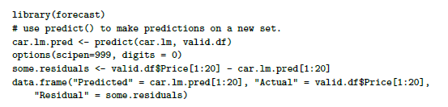
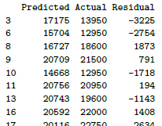
Make the Predictions for the Validation Data
(and show some residuals)
© Galit Shmueli and Peter Bruce 2017

Slide 44
How Well did the Model Do With the Validation Data?
# use accuracy() to compute common accuracy measures.
accuracy(car.lm.pred, valid.df$Price)
ME = mean error (Gives an idea of systematic over- or under-prediction)
RMSE = root mean squared error
(sq. root of mean squared error)
MAE = mean absolute error (Gives an idea of the magnitude of errors)
MPE = mean percent error
MAPE = mean absolute percent error
accuracy(car.lm.pred, valid.df$Price)
ME RMSE MAE MPE MAPE
Test set 19.6 1325 1049 -0.75 9.35
© Galit Shmueli and Peter Bruce 2017

Slide 45
Measuring Predictive error
Not the same as “goodness-of-fit”
We want to know how well the model predicts new data, not how well it fits the data it was trained with
Key component of most measures is difference between actual y and predicted y (“error”)

Slide 46
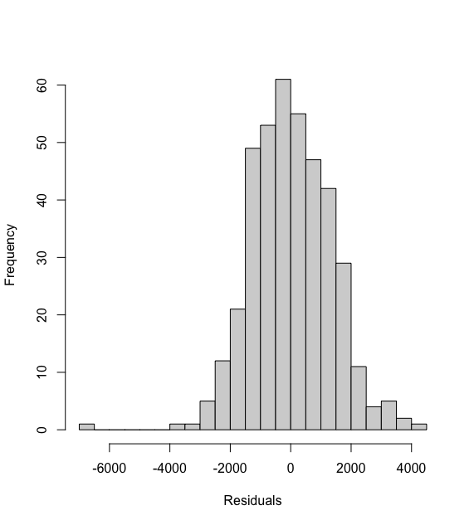
Distribution of Residuals
Symmetric distribution
A few outliers
© Galit Shmueli and Peter Bruce 2017

Slide 47
Selecting Subsets of Predictors
Goal: Find parsimonious model (the simplest model that performs sufficiently well)
More robust
Higher predictive accuracy
We will assess predictive accuracy on validation data
Exhaustive Search = “best subset”
Partial Search Algorithms
Forward
Backward
Stepwise
© Galit Shmueli and Peter Bruce 2017

Slide 48
Summary
Linear regression models are very popular tools, not only for explanatory modeling, but also for prediction
A good predictive model has high predictive accuracy (to a useful practical level)
Predictive models are fit to training data, and predictive accuracy is evaluated on a separate validation data set
Removing redundant predictors is key to achieving predictive accuracy and robustness
Subset selection methods help find “good” candidate models. These should then be run and assessed.
© Galit Shmueli and Peter Bruce 2017

